Slide 1
Beautiful soap Web scraper
Scott Anderwald
MSDS 6306
8/14/2016

Slide 2
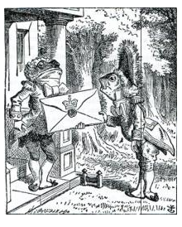
Yes it called Beautiful soup
Image from the Beautiful Soup Website
created by Leonard Richardson sometime around 2004
library designed for pulling data out of html and xml.
works with your favorite parser to navigate, search, and modify a parse tree.
automatically converts incoming documents to Unicode and outgoing documents to UTF-8
“valuable data was locked up in poorly-designed websites is now within your reach.
Currently on version 4.0

Slide 3
Installing the module
the easiest method I found was to create a path the directory for python and install from the command prompt window.
Control panel/Advance setting
create to path to Python
run python from command prompt
install in the command prompt window

Slide 4
Screen capture of the commands
# -*- coding: utf-8 -*- from bs4 import BeautifulSoup #using prettify html_markup = """<p class="ecopyramid"> <ul id="producers"> <li class="producerlist"> <div class="name">plants</div> <div class="number">100000</div> </li> <li class="producerlist"> <div class="name">algae</div> <div class="number">100000</div> </li> </ul>""" soup = BeautifulSoup(html_markup,"lxml") print(soup.prettify()) producer_entry = soup.ul print(producer_entry.prettify()) #using str print(str(soup))

Slide 5
a few issues
Prior to version 3.0 Beautiful soup needed URLLIB2 to be imported.
with 3.0 it is built in and name urllib

Slide 6
Websites
https://www.crummy.com/software/BeautifulSoup/
https://media.readthedocs.org/pdf/beautiful-soup-4/latest/beautiful-soup-4.pdf
https://beautiful-soup-4.readthedocs.io/en/latest/
https://github.com/leonardr
There is a book out there by Vineeth G Nair called Getting Started with Beautiful Soup.

Slide 7
Thanks

